Slide 1
SOFTWARE ENGINEERING AND HEALTH INFORMATICS
TERM PROJECT
GET AN OPINION
-VENKATA NAGA SAI POOJASWINI KUNTA
STUDENT ID: 02500396

Slide 2
IDEA
"GET AN OPINION” will help people who want to get an opinion from doctors about their health reports before they get an in-person doctor appointment.
In "GET AN OPINION", the doctors will only give an opinion and not prescribe any medication. They will address the patient's concerns as the patient will have to wait for few days to get an appointment in the hospital. The patient can either choose a chat-box consultation or a video call consultation, each of which will have separate price for consultation.

Slide 3
MOTIVATION
The medical report format is generally not understandable by a patient and the format varies from place- to - place. Health is a very sensitive matter, and it puts patients into a lot of confusion and thinking.
Hospitals will upload the electronic medical reports to maintain transparency between them and the patient. I came across a challenge regarding the difficulty to understand the medical report format and wanted to take this forward for certain health problems. This will help patients not to follow what is given on the internet and prevent them from taking certain measures without doctor's consent.

Slide 4
FEATURES
Patient can schedule New appointments and view Past appointments
Patient must choose the problem
Patient should fill out the concerns form so that doctor will understand what the patient’s concern is about before the appointment
Type of consultation
- Chat-box
- Video call consultation
Patients can choose the doctor from the list
Patient will schedule the appointment with the doctor
Billing for the consultation
Patient should give access to doctor to view medical report
Summary notes will be written by doctor
Recordings, chat sessions and summary will be available in past appointments

Slide 5
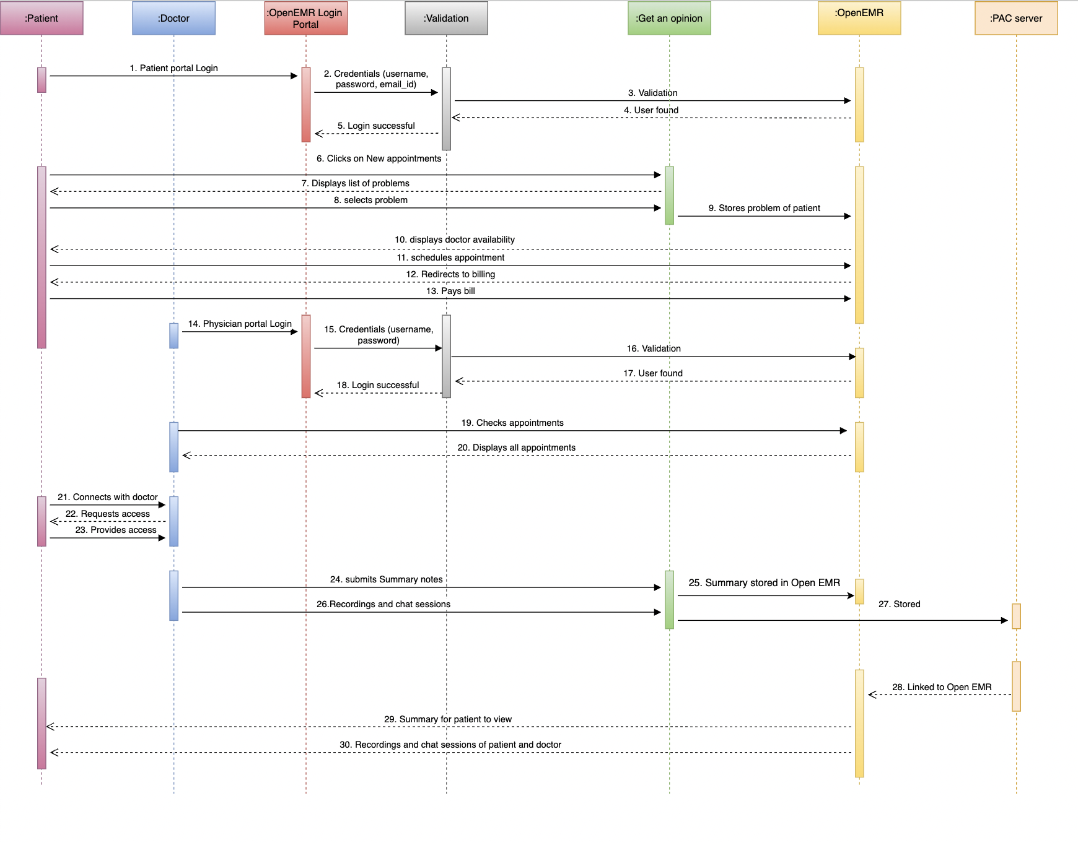
SEQUENCE UML DIAGRAM

Slide 6
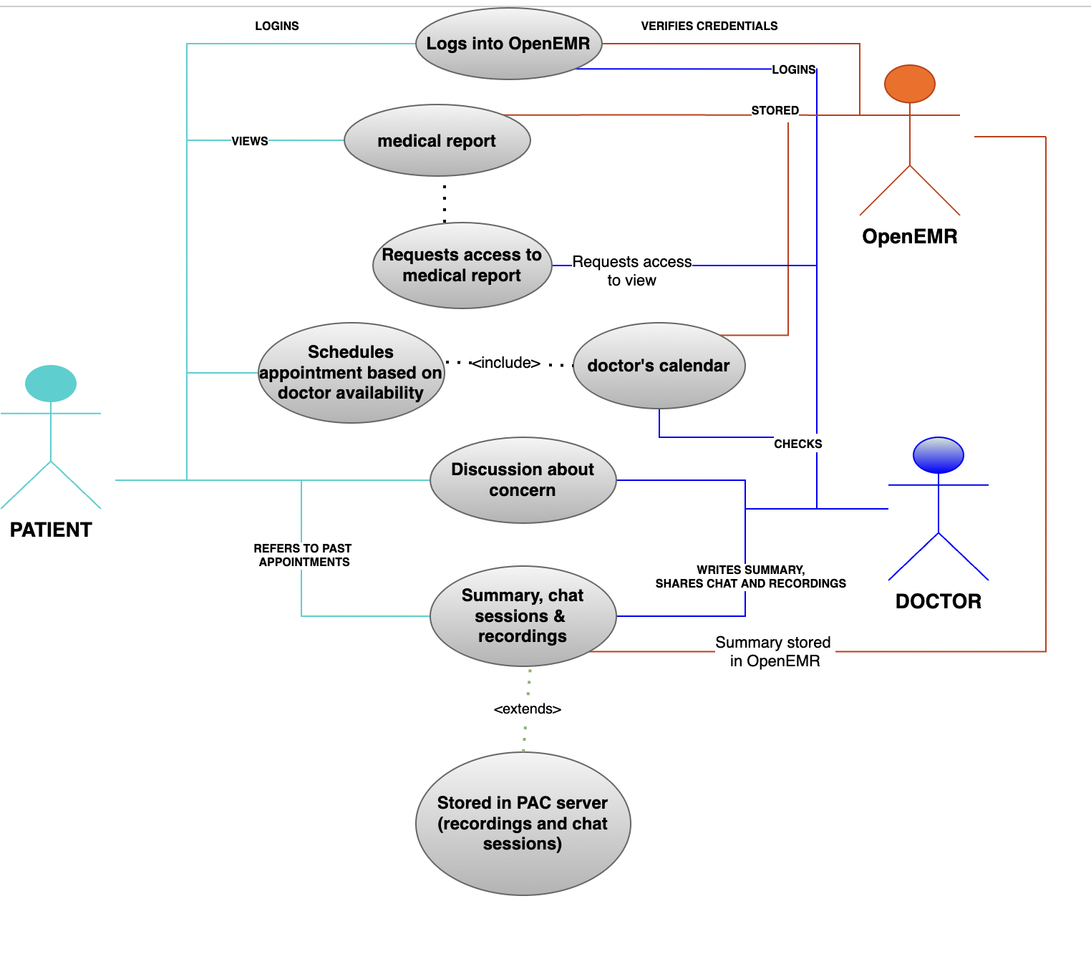
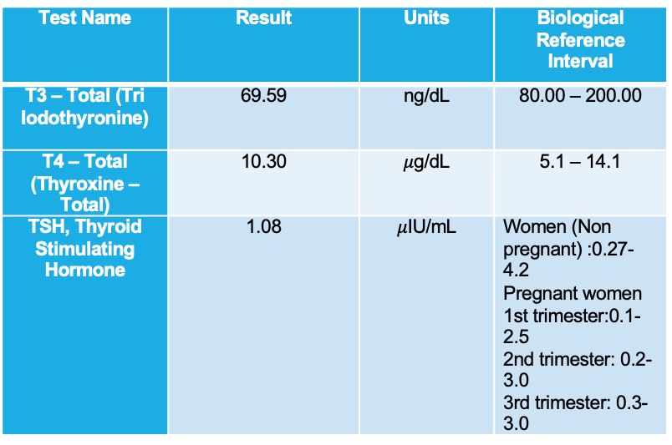
USECASE UML DIAGRAM
Example for a normal case
Test Name | Result | Units | Biological Reference Interval
T3 – Total (Tri Iodothyronine) | 69.59 | ng/dL | 80.00 – 200.00
T4 – Total (Thyroxine – Total) | 10.30 | $μ$g/dL | 5.1 – 14.1
TSH, Thyroid Stimulating Hormone | 1.08 | $μ$IU/mL | Women (Non pregnant) :0.27- 4.2 Pregnant women 1st trimester:0.1-2.5 2nd trimester: 0.2-3.0 3rd trimester: 0.3-3.0

Slide 7
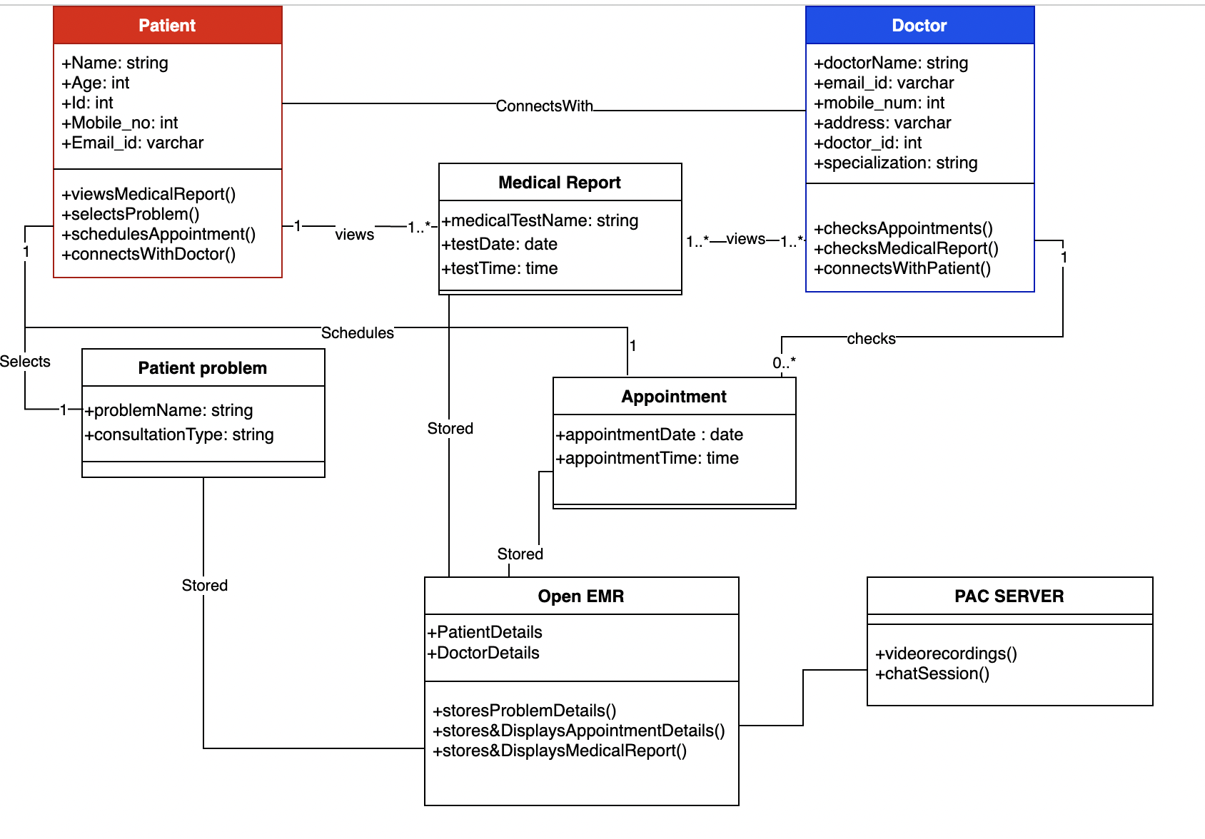
CLASS UML DIAGRAM

Slide 8
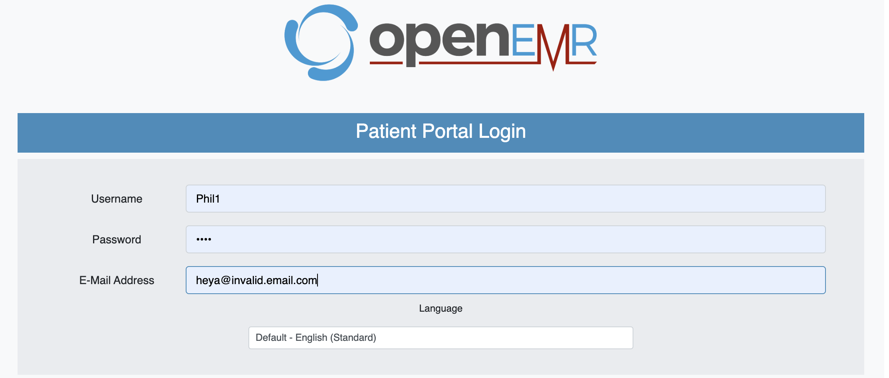
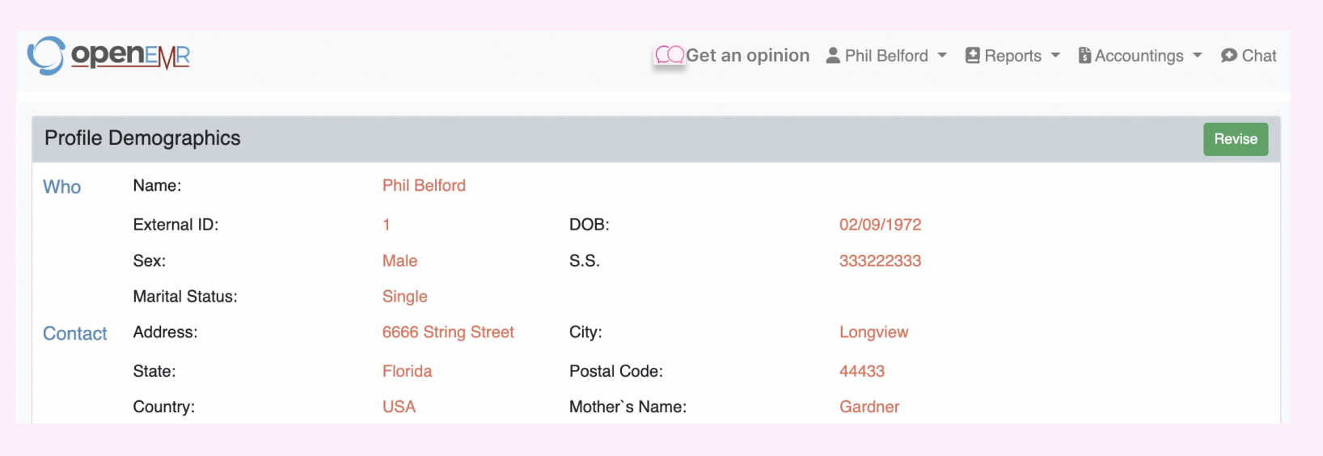
DESIGN SCREENS
OpenEMR Patient login portal
After logging in, the patient will have an option
“Get an opinion”

Slide 9

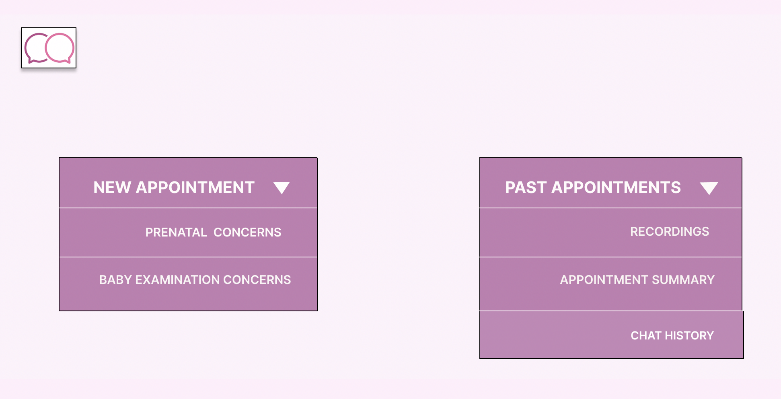
Get an opinion home page
Patient can schedule a new appointment by selecting a problem or check past appointments.
When patient selects a problem, it is stored in patient problems table in OpenEMR.

Slide 10
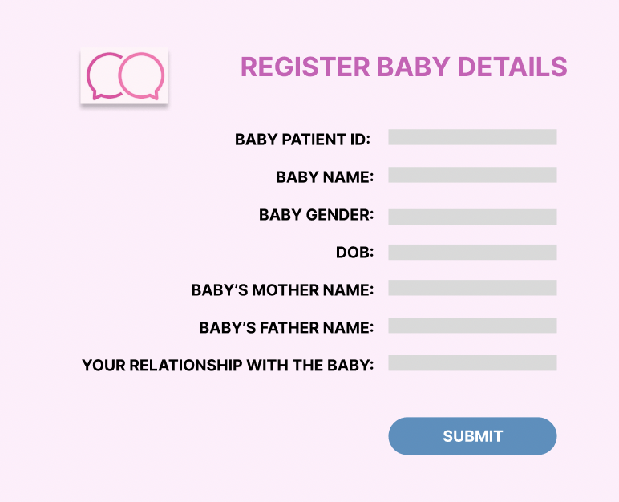
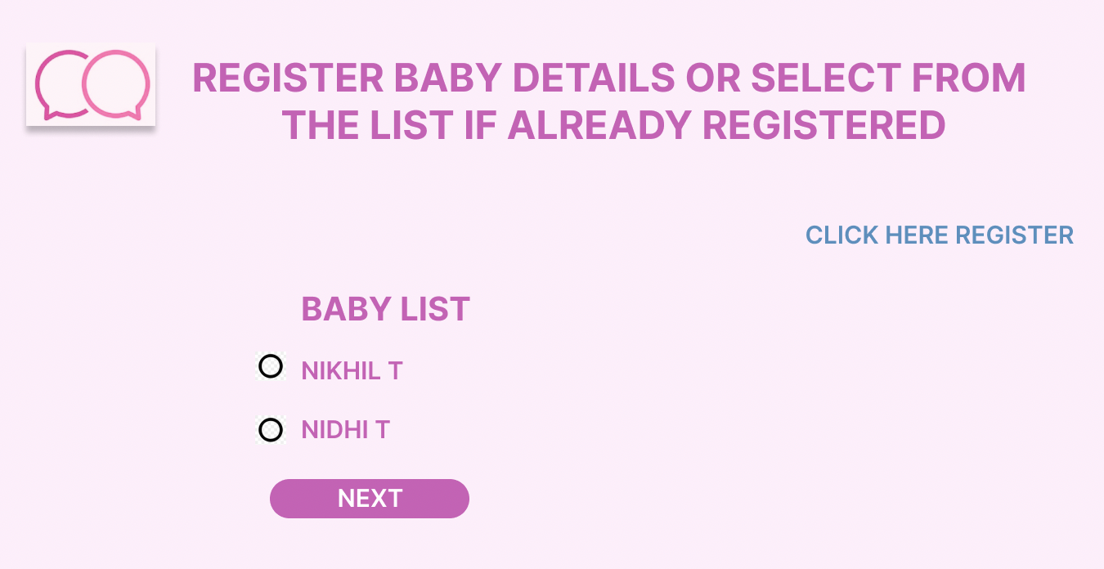
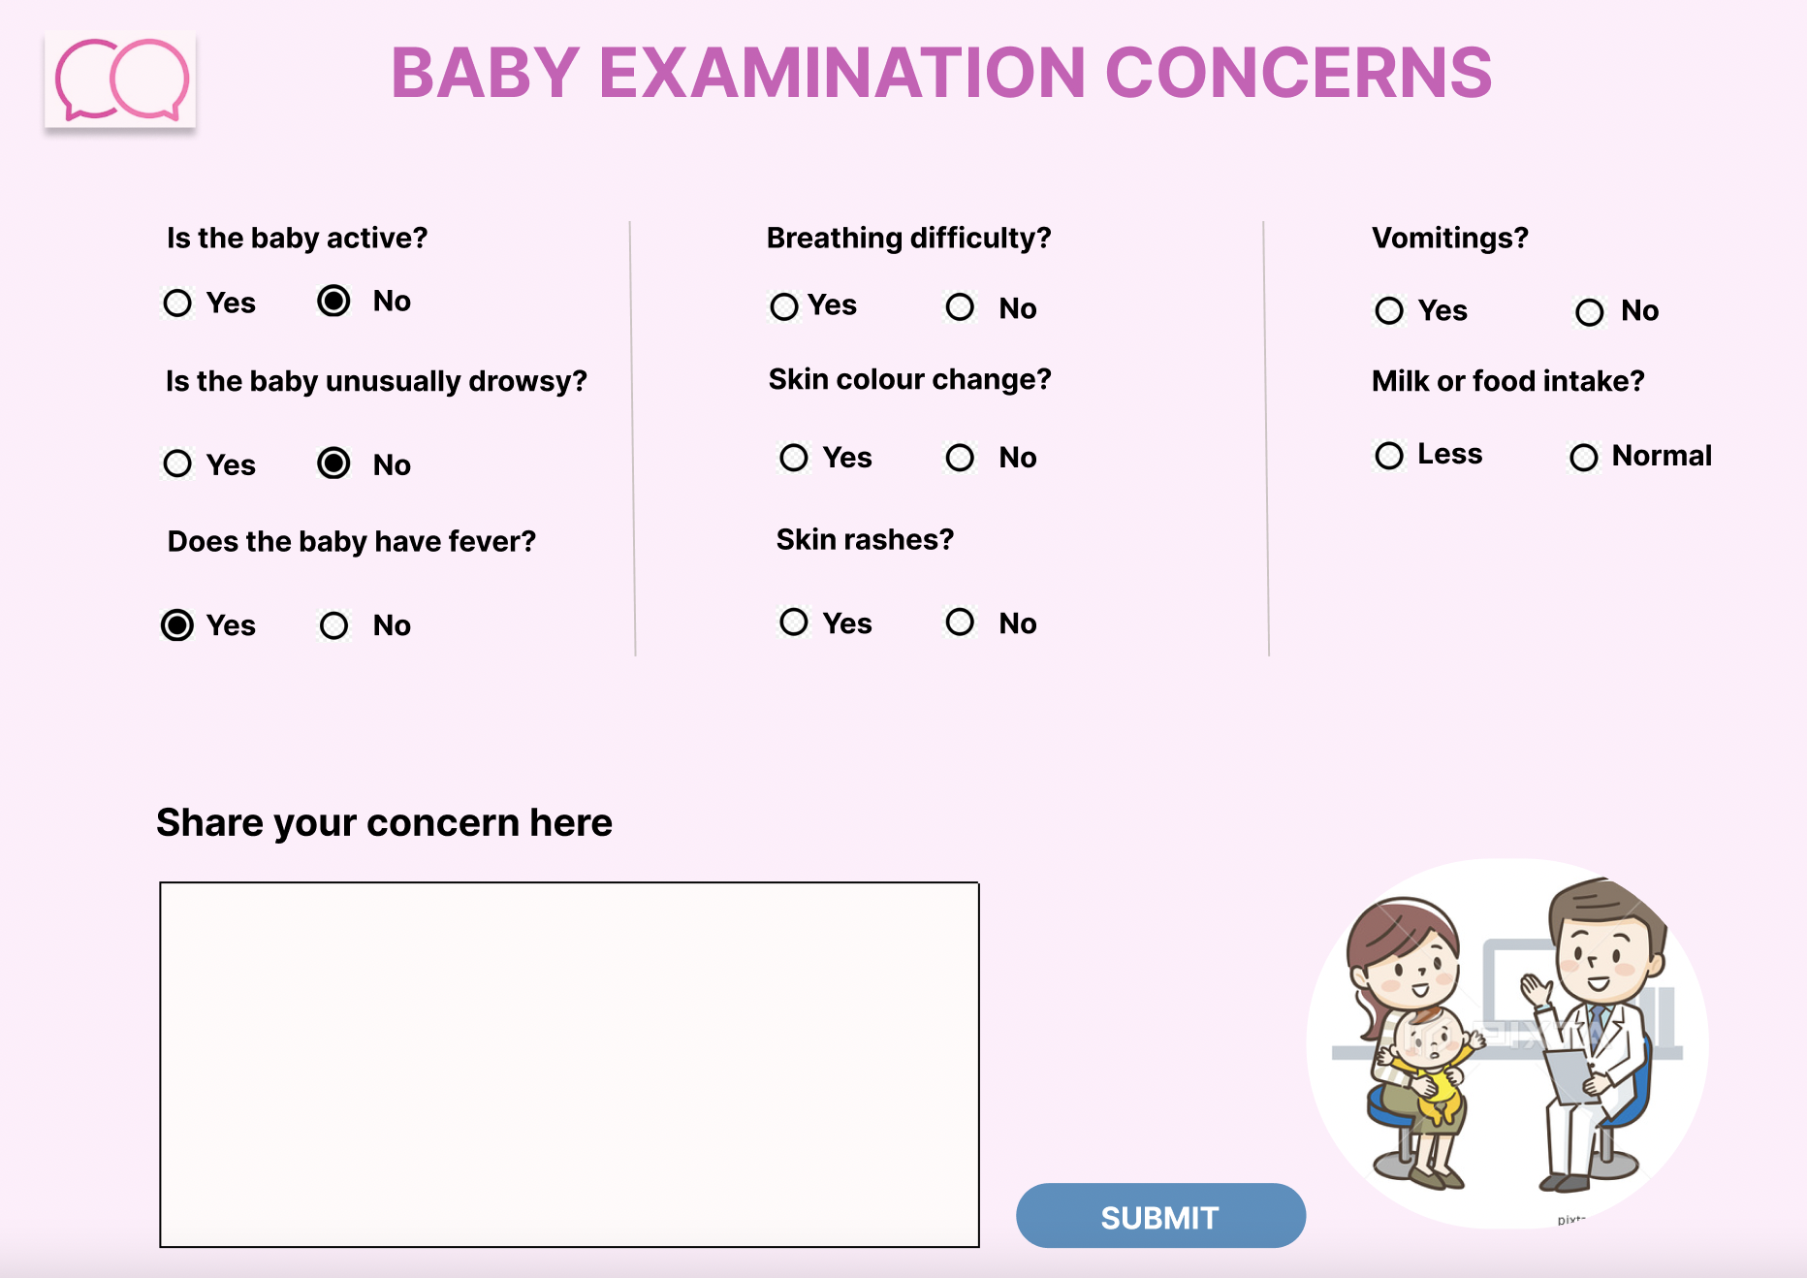
Baby Examination Concerns
When we newly register a baby, we must give baby’s patient id, and parent’s patient Id will be a foreign key in baby table in OpenEMR. Once we register the baby's details, names will appear in the baby list as in the screen above. We get baby’s patient Id from OpenEMR medical reports. Parent should fill out the concerns form so that the doctor will understand the concern before the appointment. The concerns will be stored along with doctor’s response in summary table.

Slide 11
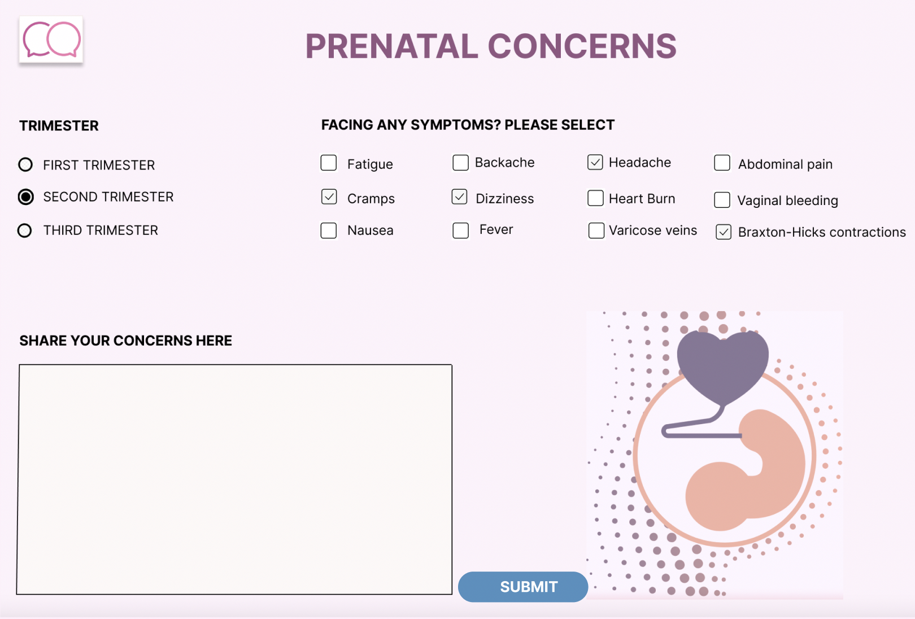
Prenatal Concerns Form
The patient must fill the form so that the doctor will know the concern before the appointment. The concerns will be stored along with the doctor’s response in the summary table in Open EMR

Slide 12
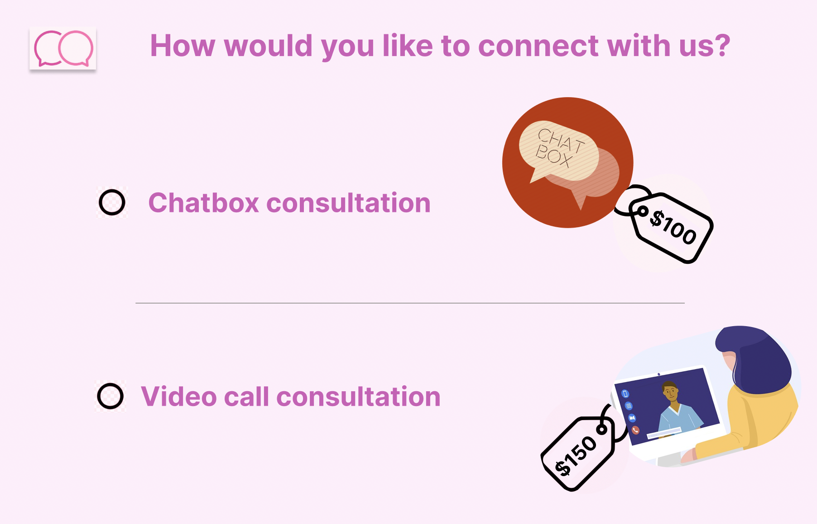
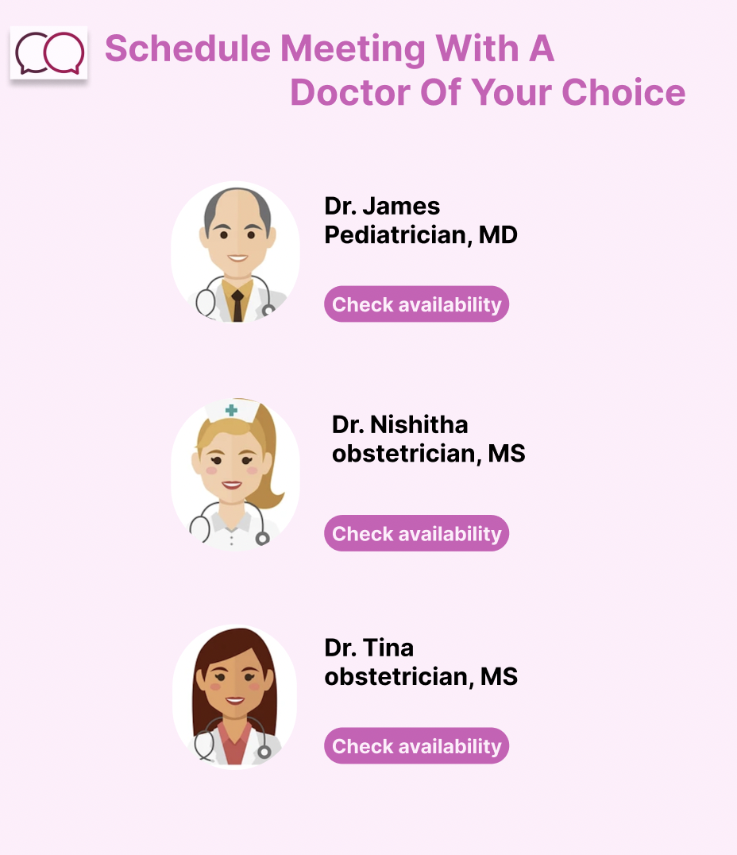
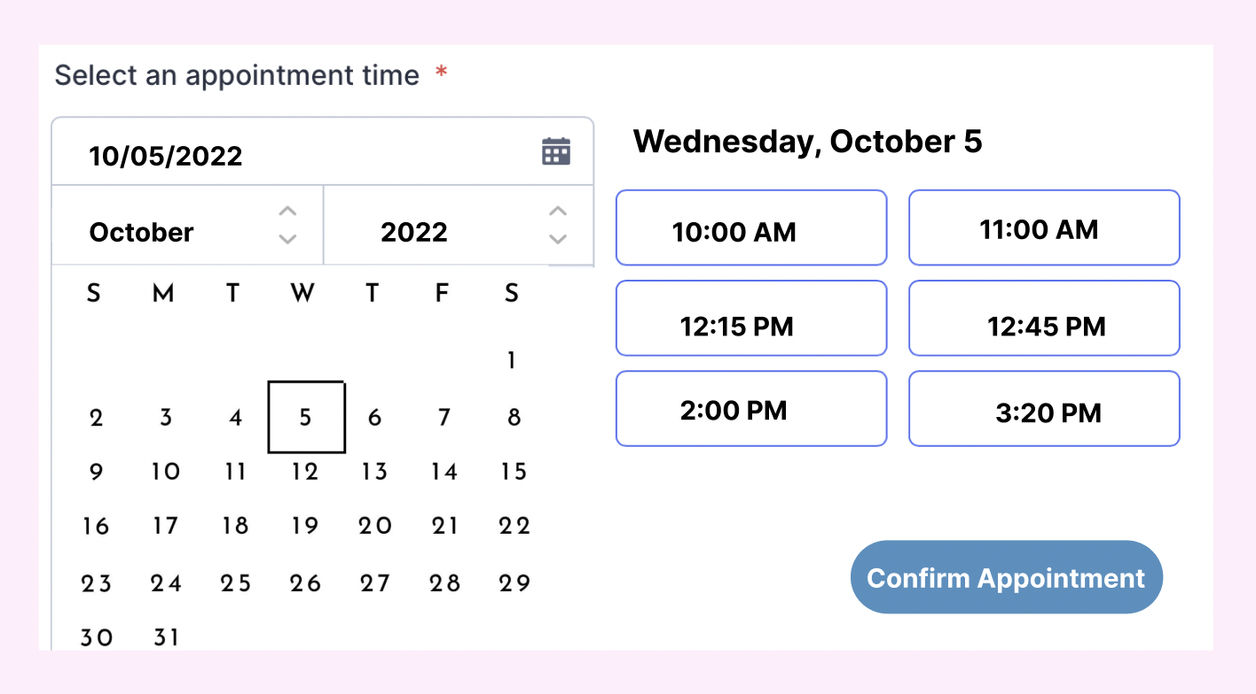
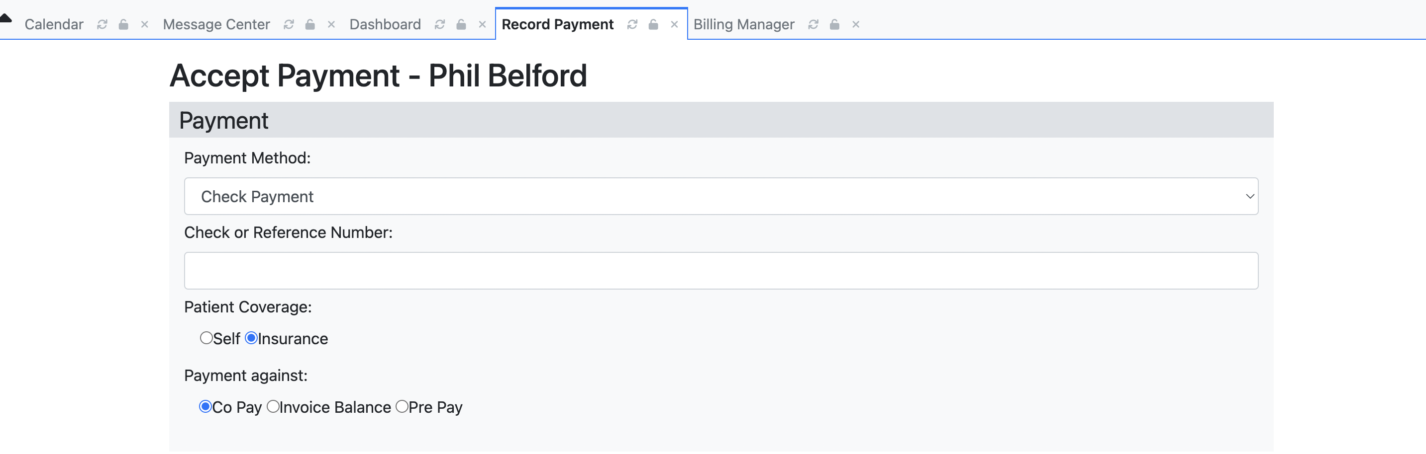
List of doctors and availability comes from Open EMR
Patient should choose the type of consultation, stored in
patient problem table in Open EMR
Redirects to
OpenEMR billing section
Stores transaction details in OpenEMR
Appointment scheduling : Details are stored in Open EMR

Slide 13
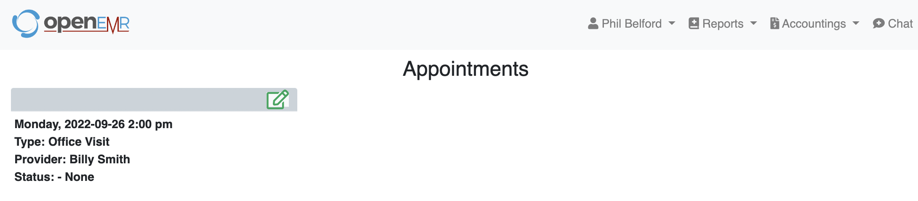
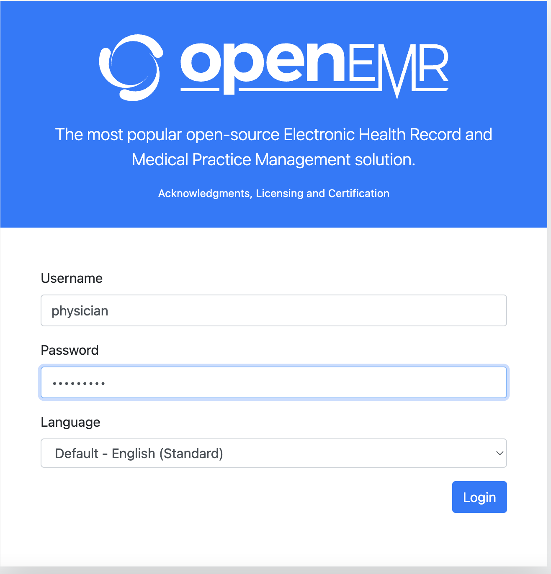
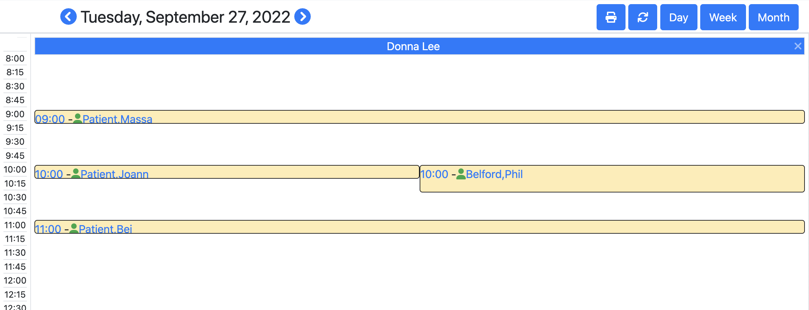
Patient portal will have patient’s appointment details once it is scheduled
In the doctor’s portal, the doctor can check the appointments in the calendar
Doctor’s login page

Slide 14
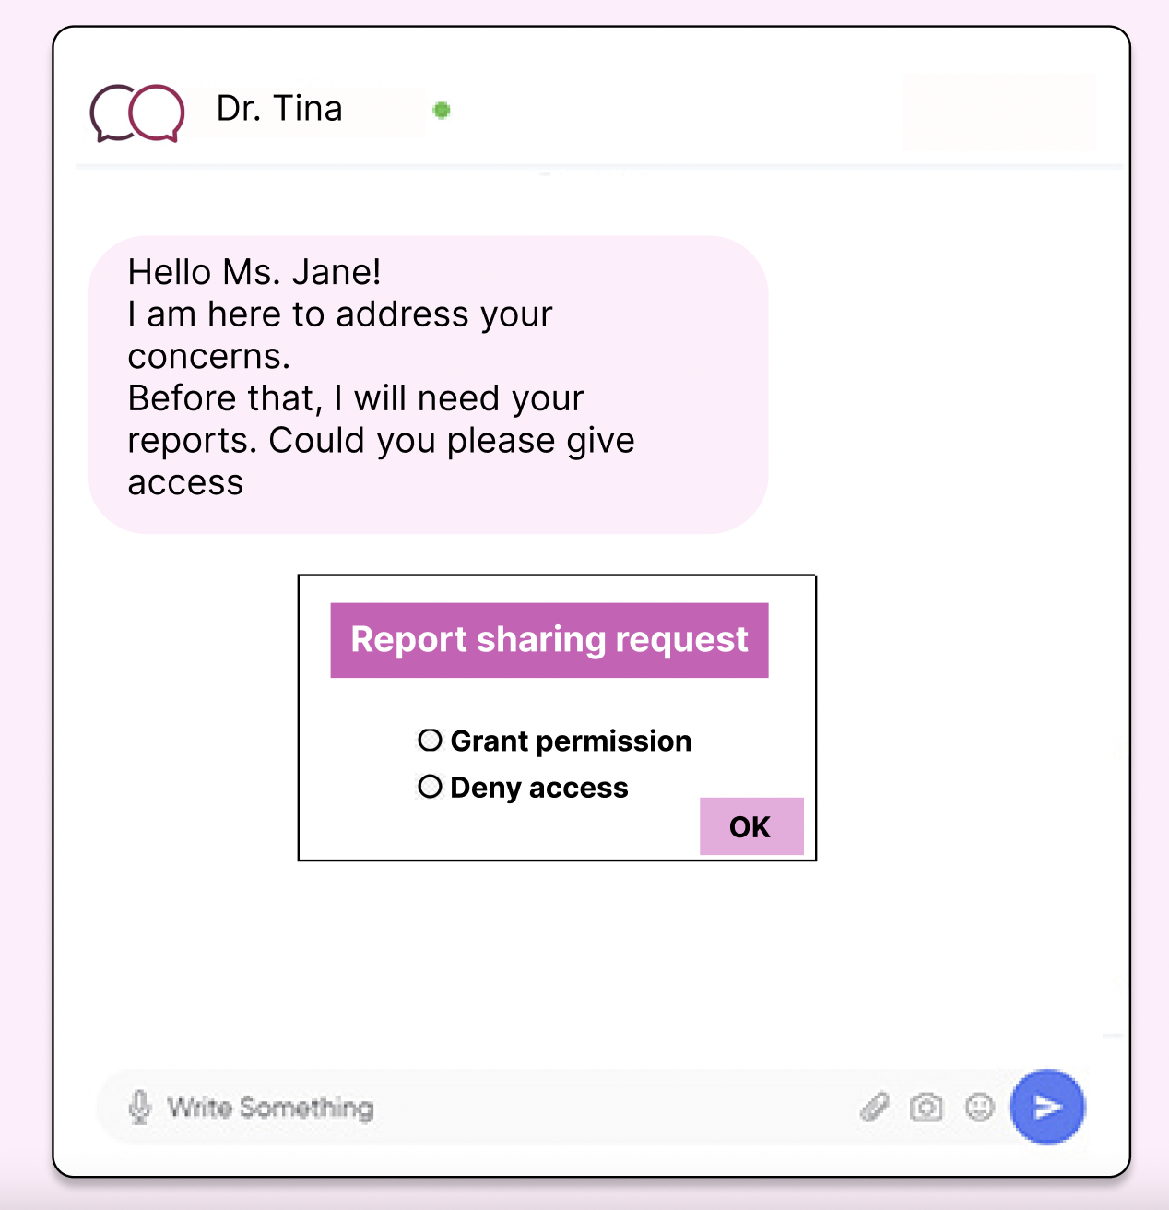
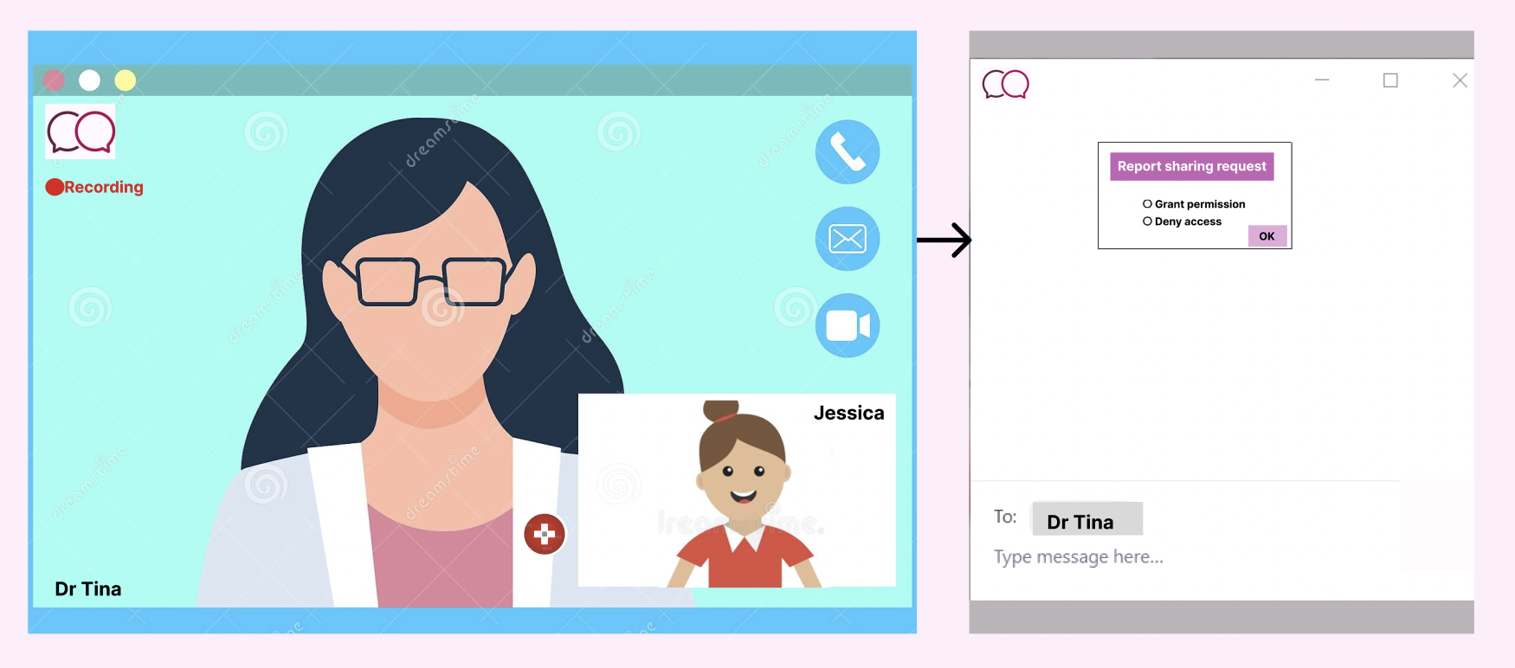
CONSULTATION
VIDEO CONSULTATION
CHAT-BOX
During video call consultation and chat-box consultation, doctor will ask the patient to provide access to view medical report. The chat session and video consultation recording are stored in PAC server. These are available to the patient in the past appointments section.

Slide 15
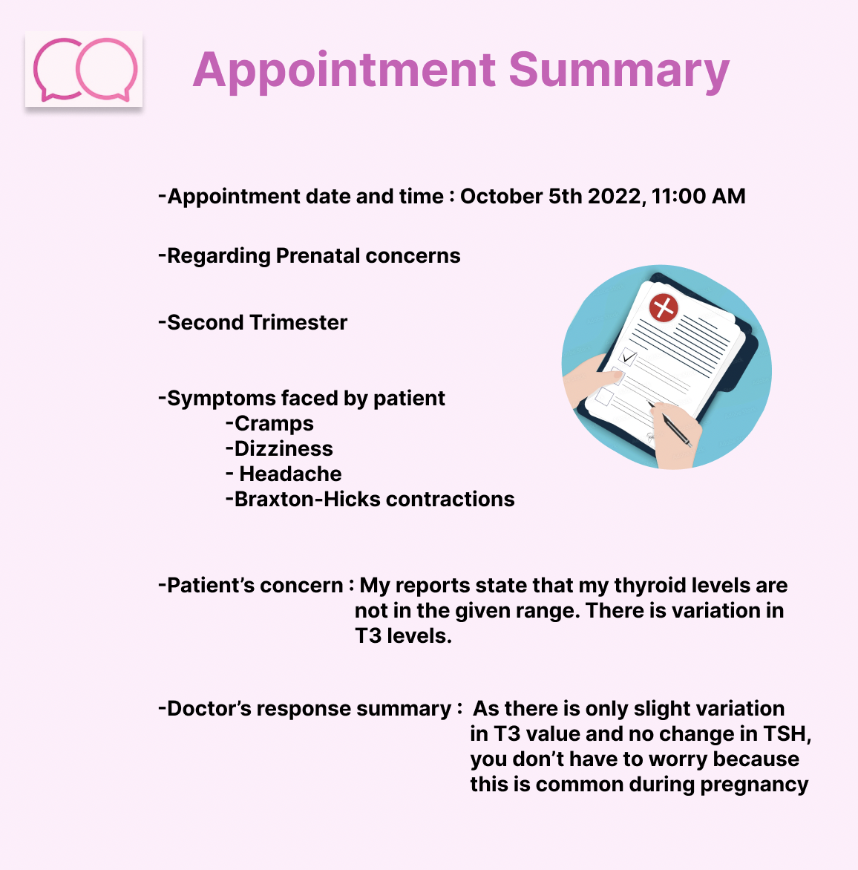
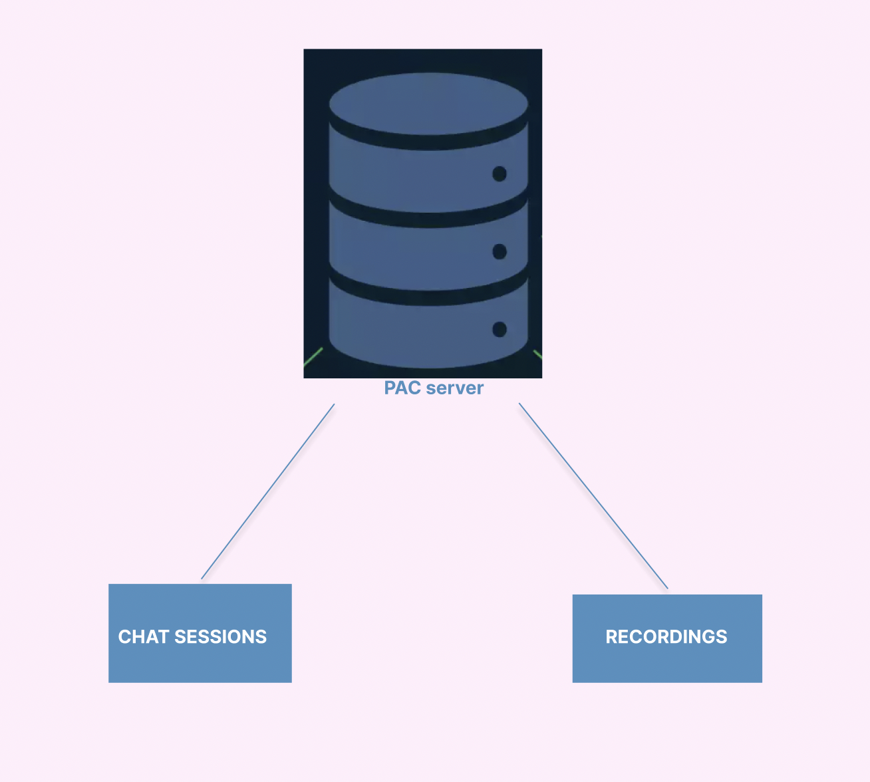
Appointment summary has patient’s concern along with doctor’s response stored in summary table in Open EMR
Recordings and chat sessions are stored in PAC server and linked to OpenEMR

Slide 16
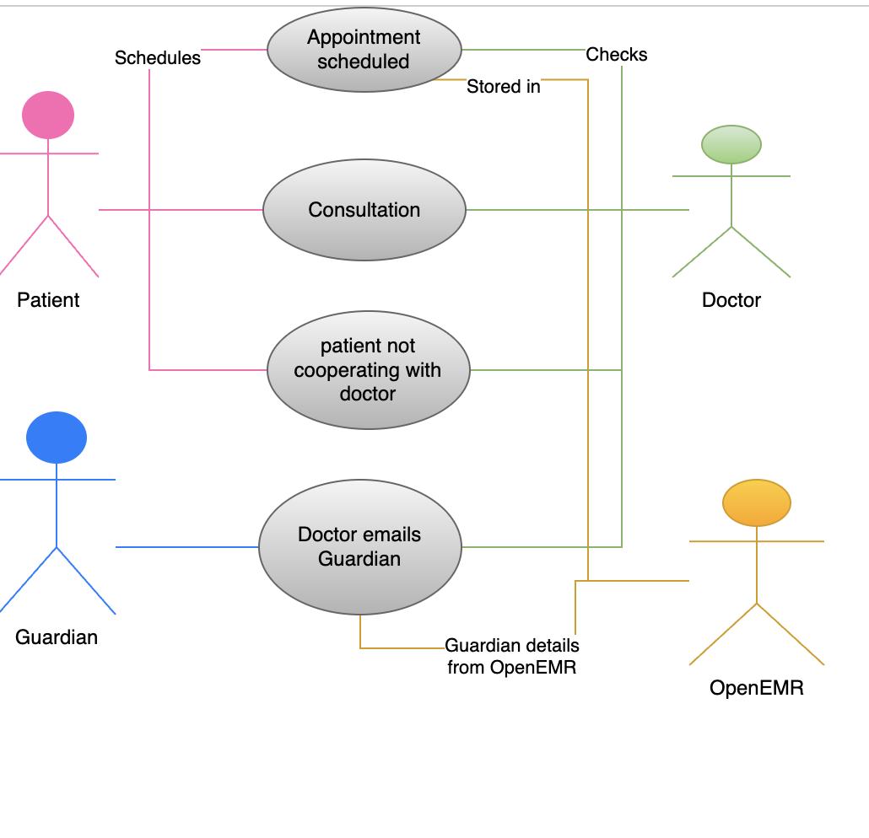
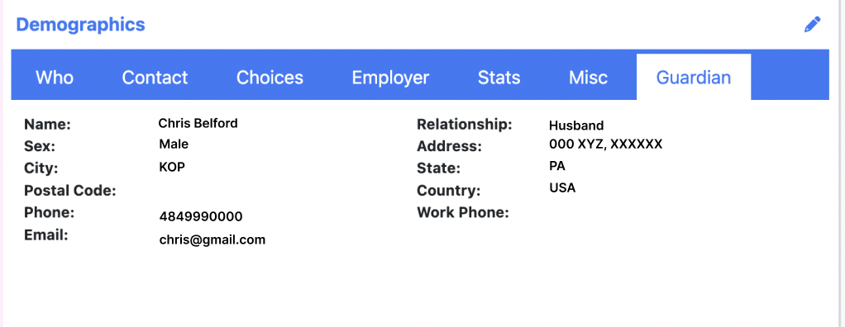
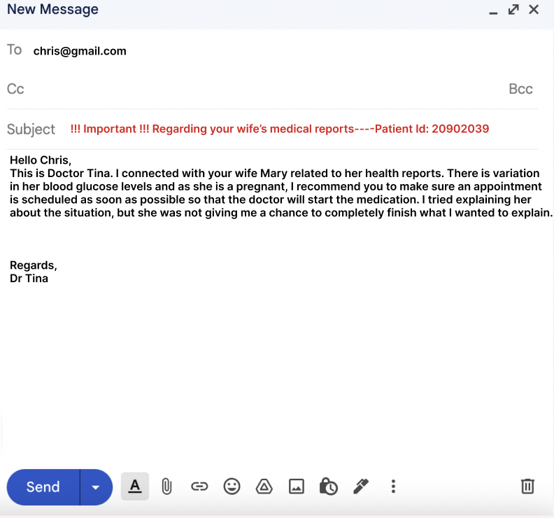
If the patient does not cooperate with the doctor
If the patient does not cooperate, the doctor will send out an email to the guardian about what should be done. Guardian email Id is taken from demographics section of open EMR

Slide 17
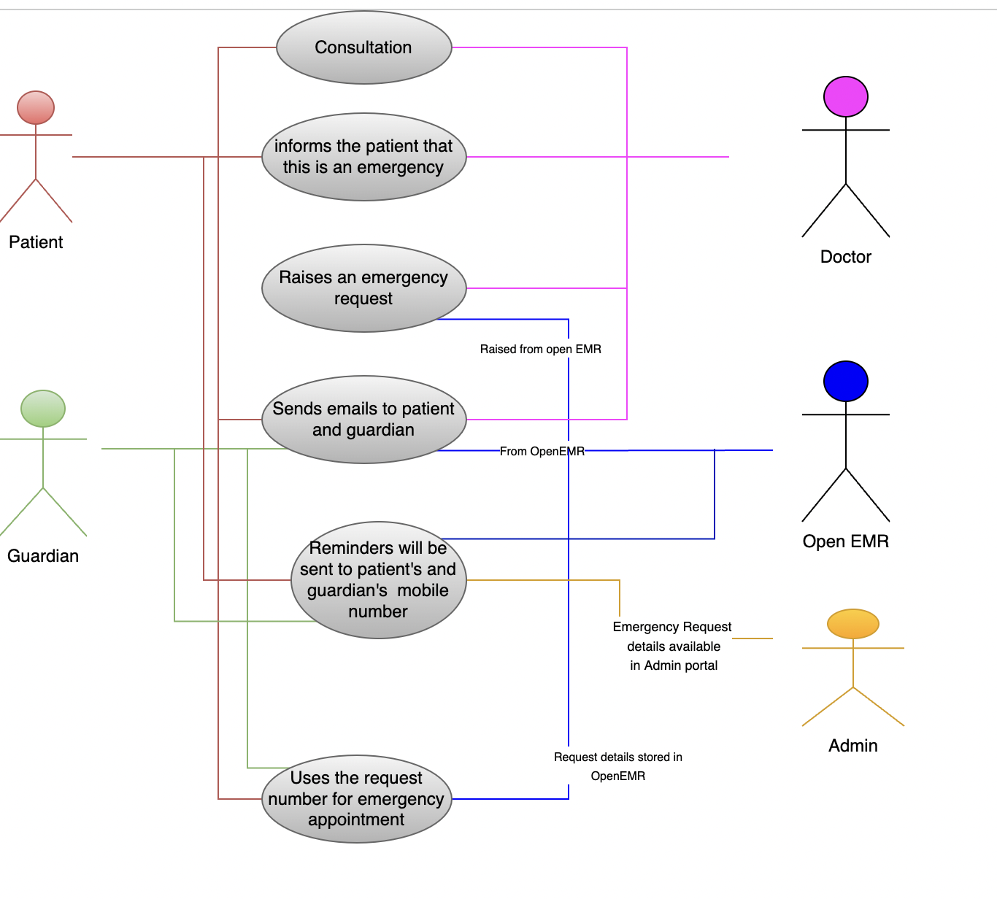
EMERGENCY CASE
Examples of emergency case
If a pregnant women is detected with protein existence in the CUE report along with High BP, it is an emergency, and the doctor will raise an emergency request
If a baby’s jaundice report shows the baby has pathological jaundice, doctor would raise an emergency request as the baby needs Pathotherapy (exposed to light)

Slide 18
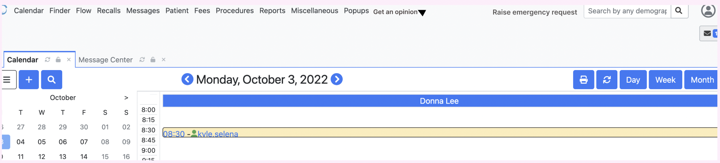
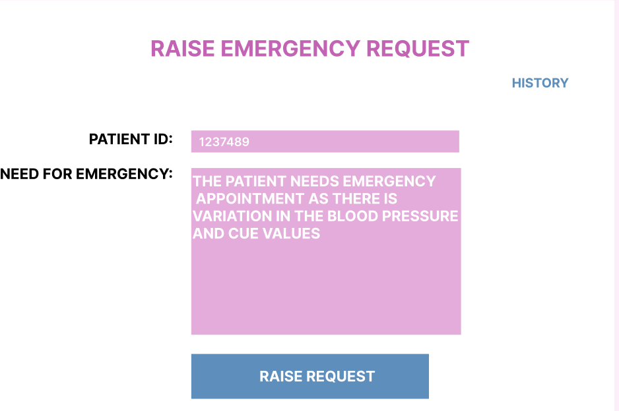
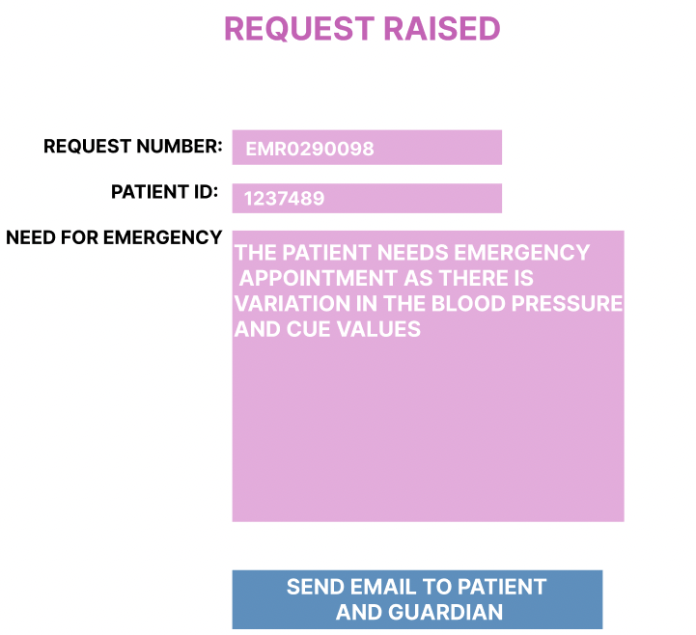
After viewing the report, if the doctor feels it is an emergency, doctor will raise emergency request which will be available in the doctor’s portal. Request number will be generated, and doctor will email these details to the patient and the guardian. The ‘History’ section contains all the requests raised by the doctor. These details are stored in a Request table in open EMR.
We get patient Id, emails of patient and guardian from Open EMR
Once this is done, the request will be added to emergency request list in admin portal.

Slide 19
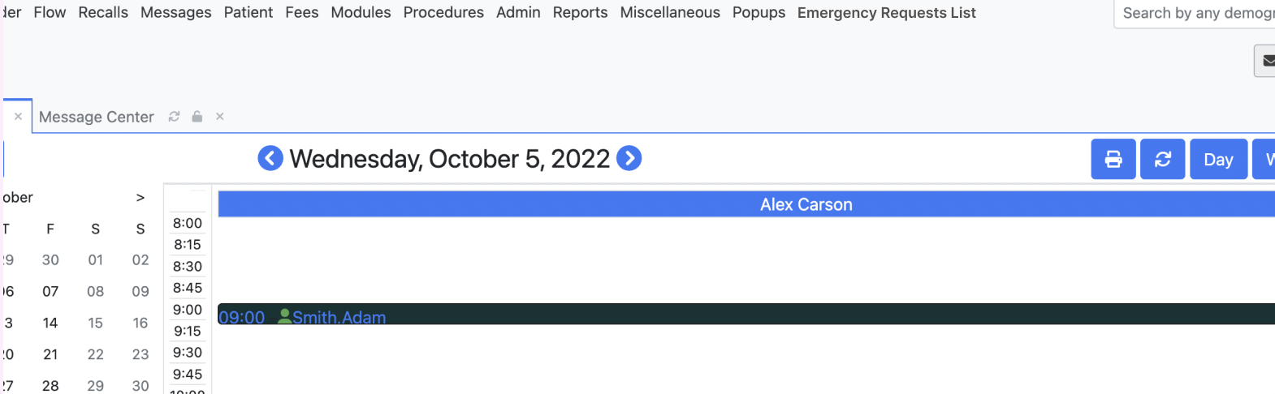
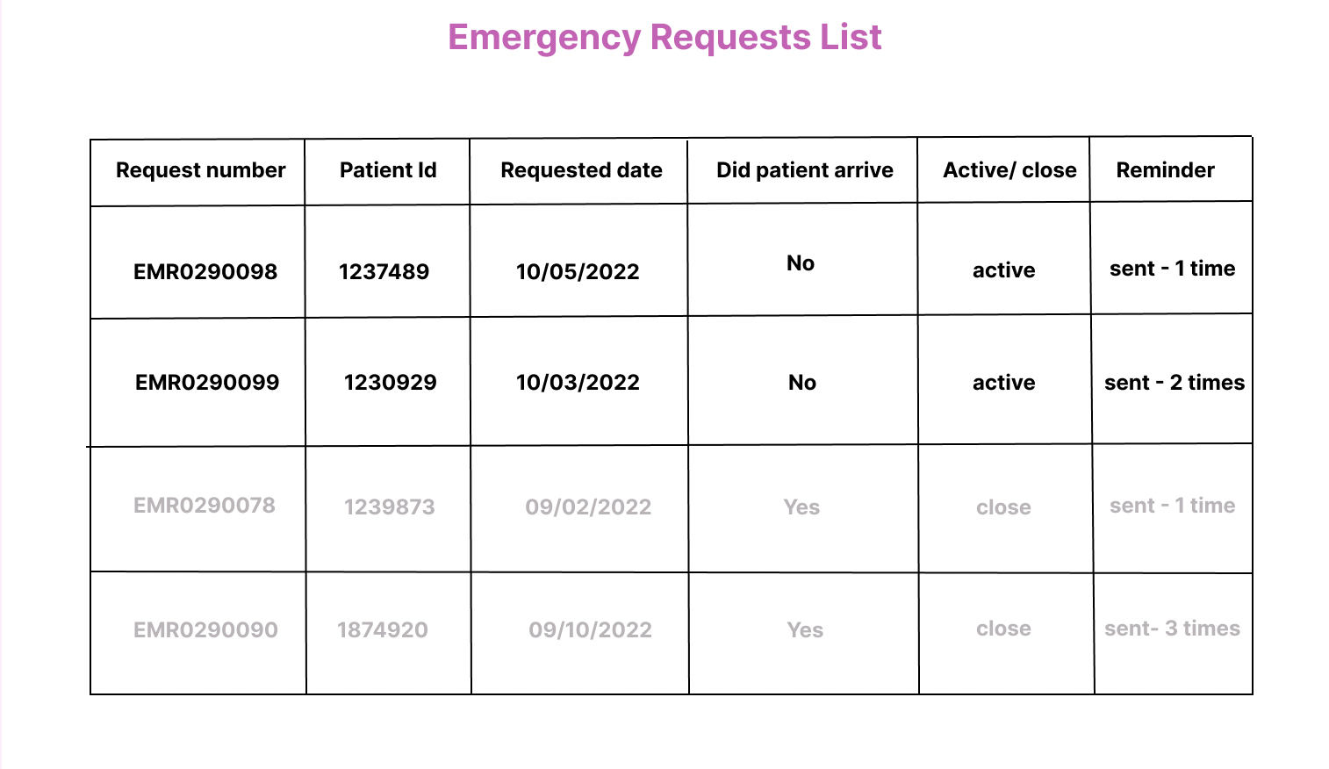
This is in the admin’s portal
Emergency Request List has all the emergency requests along with a reminder section, which will send 3 reminders to the patient and the guardian to let them know they have an emergency request from the doctor. All these are stored in the same Request table as mentioned before in OpenEMR

Slide 20
Thank you
Any Suggestions or Questions?

Slide 21
REFERENCES
https://www.open-emr.org/demo/
https://demo.openemr.io/openemr/portal/index.php
https://demo.openemr.io/openemr/interface/login/login.php?site=default
https://journals.sagepub.com/doi/full/10.4137/BII.S2223
Icons Links
https://www.careopinion.org.uk/info/link-to-us
https://stock.adobe.com/search?k=doctor+patient+icon
https://www.istockphoto.com/vector/stethoscope-icon-with-editable-stroke-and-pixel-perfect-gm1191928633-338472438
https://stock.adobe.com/images/black-online-medical-help-line-icon-simple-professional-ehealth-service-flat-design-pictogram-infographic-vector-for-app-logo-web-website-button-ui-ux-interface-elements-isolated-on-white-background/450155813?as_campaign=ftmigration2&as_channel=dpcft&as_campclass=brand&as_source=ft_web&as_camptype=acquisition&as_audience=users&as_content=closure_asset-detail-page
https://www.pixtastock.com/illustration/53925210
https://www.igenomix.eu/our-services/nace-non-invasive-prenatal-test/
https://thenounproject.com/icon/radio-button-1016504/
https://icons8.com/icon/19336/unchecked-checkbox
https://www.pngitem.com/middle/hiwbhRJ_checked-checkbox-icon-hd-png-download/

Slide 22
REFERENCES
https://www.seekpng.com/ipng/u2q8q8a9t4o0q8u2_price-tag-price-tag-icon-png/
https://rcni.com/nursing-standard/newsroom/analysis/remote-nursing-consultations-how-to-get-them-right-161366
https://www.amazon.com/techbox-ChatBox-Messenger/dp/B00ZVBGATI
https://search.muz.li/MjI5NDFmNWZi
https://www.dreamstime.com/medical-video-consultation-female-doctor-glasses-man-patient-portrait-closeup-view-people-hospital-online-healthcare-image165744504
https://superuser.com/questions/1568272/in-zoom-chat-how-do-you-pop-the-chat-back-in-after-it-popped-out
https://www.dreamstime.com/women-female-girl-people-consultant-table-information-desk-counter-microphone-women-female-girl-people-consultant-table-image101918532
https://www.jotform.com/answers/2837544-how-can-i-change-appointment-time-slots
https://in.pinterest.com/pin/38280665573489248/
https://www.shutterstock.com/image-vector/medicine-flat-avatars-set-doctors-nurses-691183393
https://mail.google.com/
https://www.altexsoft.com/blog/pacs-vna/
https://stock.adobe.com/images/flat-tablet-folder-medical-form-plan-with-check-marks-medical-history-icon-with-check-mark-pen-marks-doctor-s-hands-writing-a-prescription-vector-illustration/403060116?as_campaign=ftmigration2&as_channel=dpcft&as_campclass=brand&as_source=ft_web&as_camptype=acquisition&as_audience=users&as_content=closure_asset-detail-page
https://www.istockphoto.com/vector/plus-icon-vector-add-icon-addition-sign-medical-plus-icon-on-red-circle-gm1166184306-321159844

Slide 23
REFERENCES
Symptoms reference links
https://www.whattoexpect.com/third-trimester-of-pregnancy.aspx
https://www.webmd.com/baby/guide/second-trimester-of-pregnancy
https://www.webmd.com/baby/guide/first-trimester-of-pregnancy
https://www.healthdirect.gov.au/symptoms-of-serious-illness-in-babies-and-children
Examples of positive and negative cases
Spoke to a family doctor and friend who is a doctor about the examples(thyroid levels, CUE report, Jaundice)
Took reference of thyroid report from my family doctor.
https://pubmed.ncbi.nlm.nih.gov/26485458/
For UML
https://www.diagrams.net/
https://www.youtube.com/watch?v=UI6lqHOVHic
https://creately.com/diagram/example/h9256rlo1/student-login-sequence-diagram
https://www.visual-paradigm.com/guide/uml-unified-modeling-language/what-is-use-case-diagram/
For Designing
https://www.figma.com/

